Slide 1

The MVC Design Pattern, Django Intro to urls,, views and templates
Web 3

Slide 2
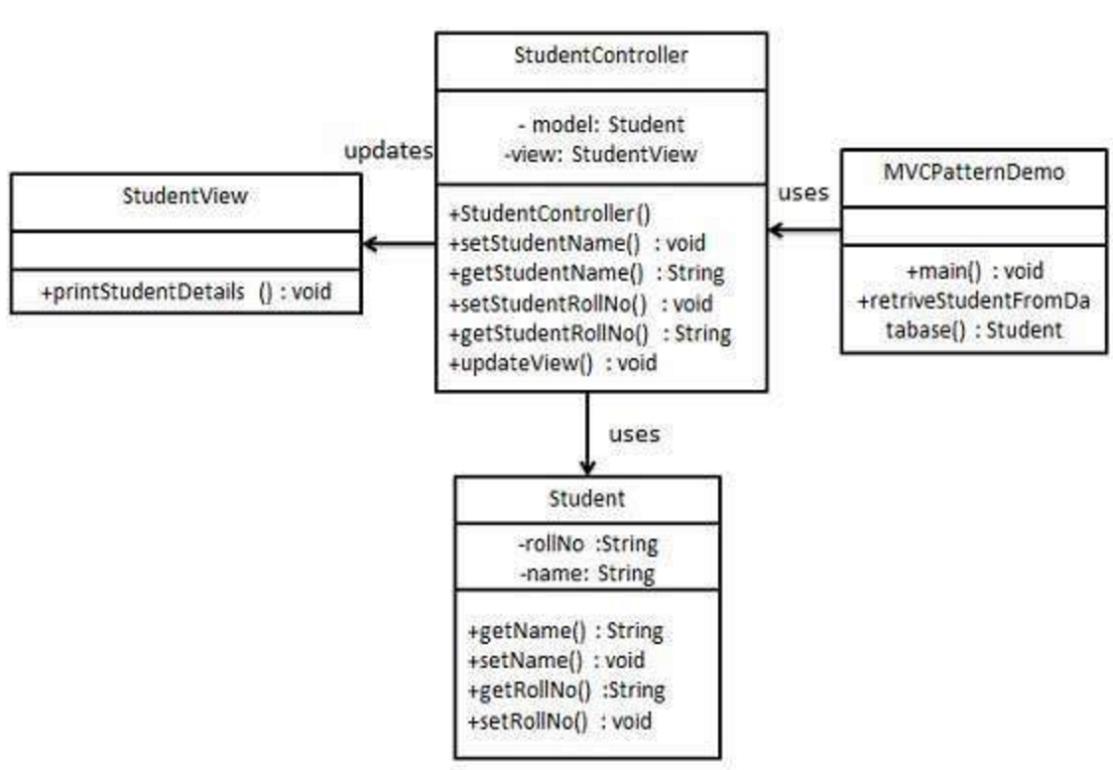
The MVC Design Pattern
Controller - acts on both model and view. It controls the data flow into model object and updates the view whenever data changes. It keeps view and model separate.
The MVC Design Pattern stands for Model-View-Controller Design Pattern.
View - represents the visualization of the data that model contains.
Model - represents an object carrying data. It can also have logic to update controller if its data changes.
This pattern is used to separate application's concerns into classes.

Slide 3
The MVC Design Pattern
Although originally developed for desktop computing, MVC has been widely adopted as an architecture for World Wide Web applications in major programming languages.
Several web frameworks have been created that enforce the pattern.
These software frameworks vary in the way that the MVC responsibilities are divided between the client and server.
Some web MVC frameworks place almost the entire model, view and controller logic on the server. This is reflected in popular frameworks such as Django, Rails and ASP.NET MVC. In this approach, the client sends either hyperlink requests or form input to the controller and then receives a complete and updated web page (or other document) from the view; the model exists entirely on the server.
As client technologies have matured, frameworks such as AngularJS, EmberJS, JavaScriptMVC and Backbone have been created that allow the MVC components to execute partly on the client

Slide 4
Django Overview
Django uses an MVC, or Model View Controller, architecture
However, Django calls these pieces by different names
MVT (model – view –template)
The four pieces to understand for Django are:
URL patterns
Views (the C in MVC)
Models (the M in MVC)
Templates ( the V in MVC)

Slide 5
Django MVT Design Pattern
URL Patterns
Views
Templates
mysite/urls.py
blog/views.py
blog/templates/
blog/urls.py
Models
blog/models.py

Slide 6
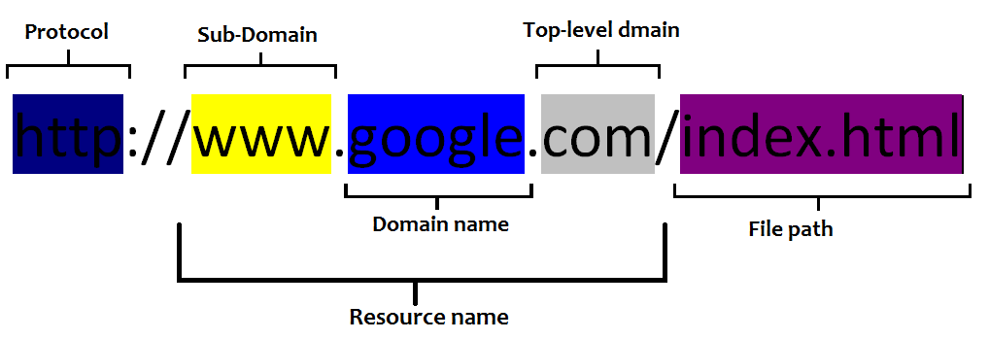
A word about URLs matching

Slide 7
Examples
Models
blog/models.py
URL Patterns
Views
Templates
mysite/urls.py
blog/views.py
blog/templates/
blog/urls.py
http://yoursite.com/
/
index
Index.html
http://yoursite.com/post/3
/post/3
post_detail
Item_detail.html

